Slide 1
"Business Analytics Capstone: Unlocking Financial Insights"
Western Countries Financial Data :-
The "Western Countries Financial Data" dataset contains 700 rows and 16 columns, providing detailed information about sales and finances. Each row represents a specific transaction, including details like the segment (Government, Midmarket), country, product, and discount band. The dataset captures key financial metrics such as units sold, manufacturing price, sale price, gross sales, discounts, net sales, cost of goods sold, and profit. It also includes dates, month numbers, month names, and years to track sales over time. This data allows for analyzing sales performance and profitability across different products and countries. It shows how many units were sold, the prices, and the resulting profit for each transaction. The dataset helps understand trends and patterns In sales, discounts, and profits across various western countries over multiple years. This comprehensive financial data can be used to identify successful products and markets, evaluate the Impact of discounts, and make informed business decisions.

Slide 2
❖ Statistical Analysis Using Excel
As part of the project on western countries' financial data, the following statistical techniques were applied using excel powerful statistical analysis tools. This analysis helped uncover key Insights and trends from the data, supporting better decision-making and a deeper understanding of financial patterns.
➢ Descriptive Statistics
Objective: Summarize the key statistics of financial data, such as mean, median, standard deviation, and more.
Method: Using Excel’s Data Analysis Tool, I selected the Descriptive Statistics option and applied it to the financial dataset. This provided a quick overview of measures like central tendency, dispersion, and the distribution shape.
Results: The output helped me understand the overall trends and patterns In the data, such as average sales and variations across different periods or regions.

Slide 3
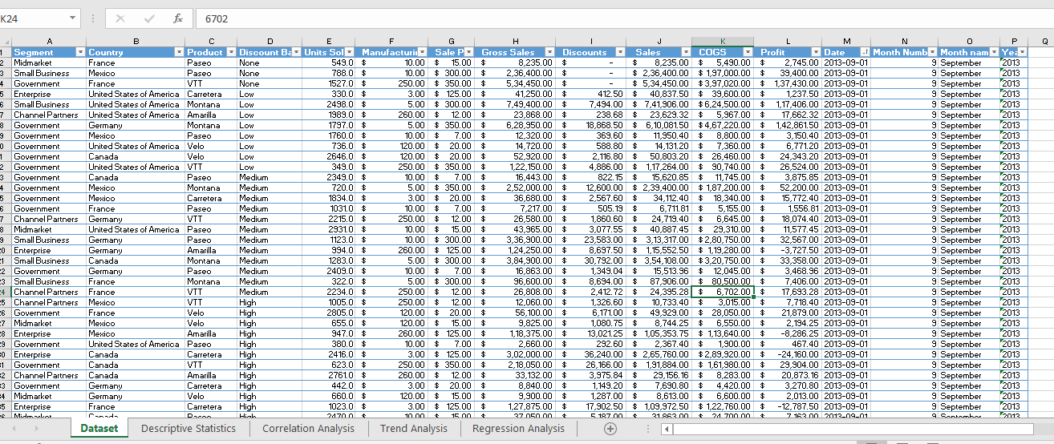

Slide 4
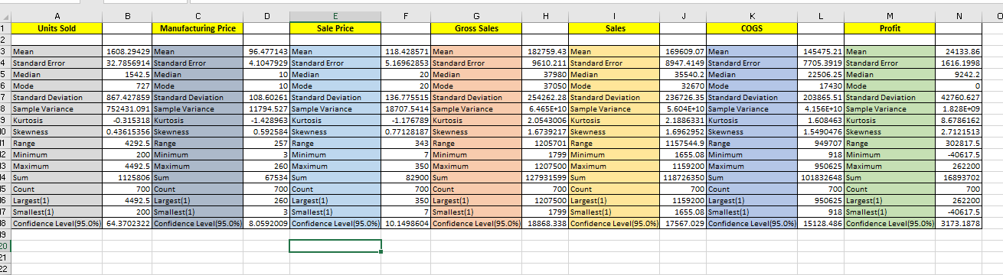

Slide 5
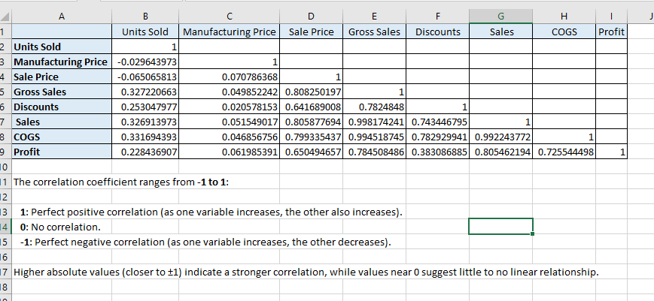
Objective: determine the strength of the relationships between various financial variables (Sales, profits, expenses). Method: by applying the correlation tool from excel data analysis suite, I was able to calculate the correlation coefficient between different variables. This showed the degree of association between key financial metrics. Results: the analysis revealed which financial Indicators were closely related, helping to identify factors that had the most Influence on sales or profits.
➢ Correlation Analysis

Slide 6
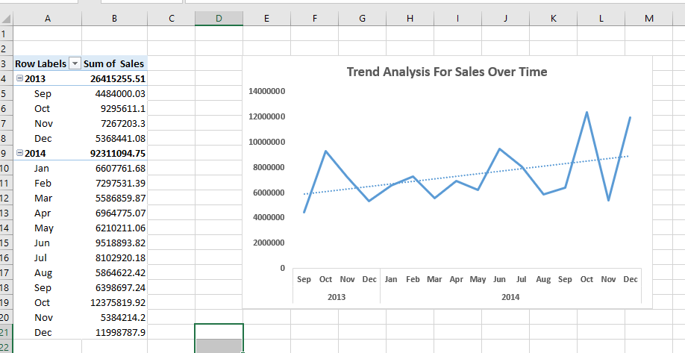
Objective: track sales performance over time to spot trends or patterns. Method: I created pivot tables in excel to summarize and group sales data by time periods (Month, quarter, year). The use of line charts visualized the sales trends over time, highlighting peaks, dips, and seasonal variations. Results: this visual representation made It easier to monitor sales growth or decline over specific periods and provided Insights into cyclical trends.
➢ Trend Analysis

Slide 7
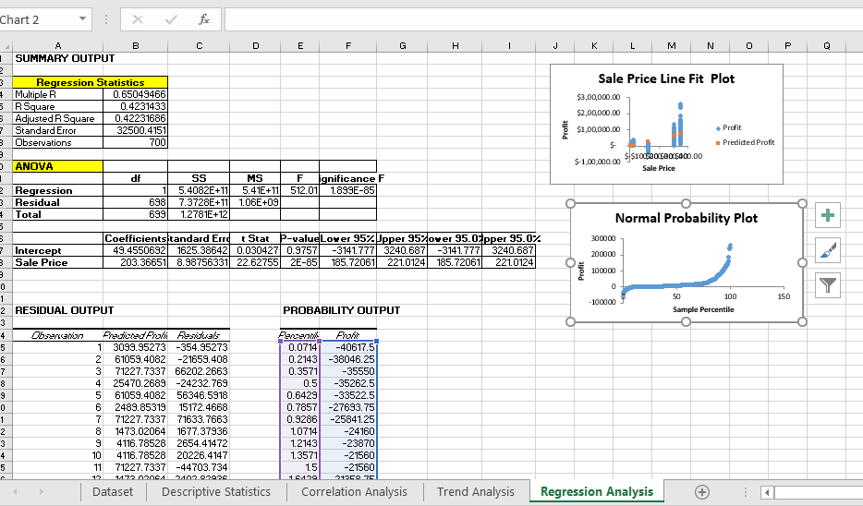
➢ Regression analysis Objective: understand the relationship between sales (dependent variable) and other factors such as marketing expenses or customer acquisition (independent variables). Method: I used the regression tool from excel data analysis suite, specifying sales as the dependent variable and various independent variables (like costs, discounts, etc.). This regression model helped explain how changes In one or more variables impacted sales performance. Results: the analysis provided key coefficients and an r-squared value, offering Insights into the predictive power of the model and highlighting significant factors driving sales.

Slide 8
➢ Graphical analysis
To visually represent key insights from the financial data, I used Excel Pivot Table Charts to create interactive and insightful graphs:
Total Sales by Country: Using a Bar Chart, I displayed total sales across different Western countries. This made it easy to compare which country contributed the most to overall sales.
Profit Distribution by Product: A Pie Chart showed how profits were distributed among various products, highlighting which products were the most profitable.
Monthly Sales Trend: I used a Line Chart to visualize sales trends over time, showing sales growth and decline across months. This highlighted seasonal variations.
Units Sold by Segment: A Stacked Column Chart broke down units sold by different market segments (Small Business, Government), helping Identify which segment drove the most volume.

Slide 9
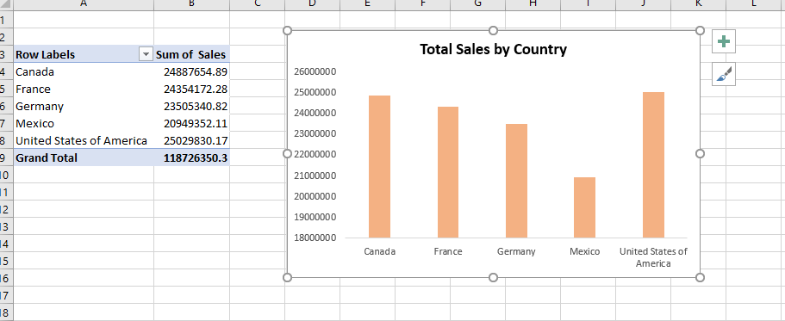

Slide 10
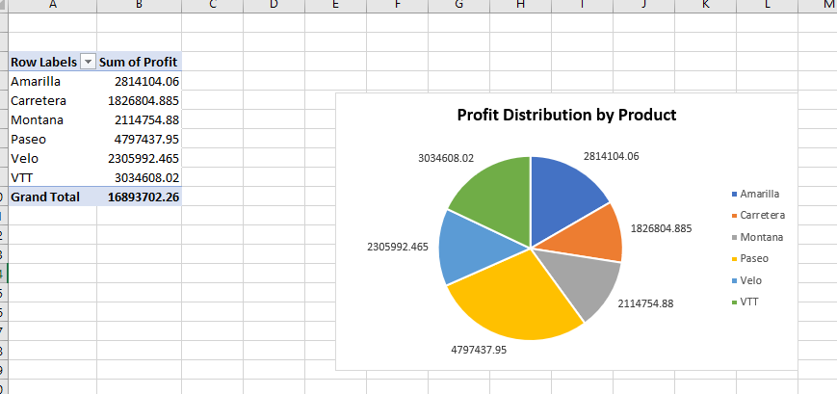

Slide 11
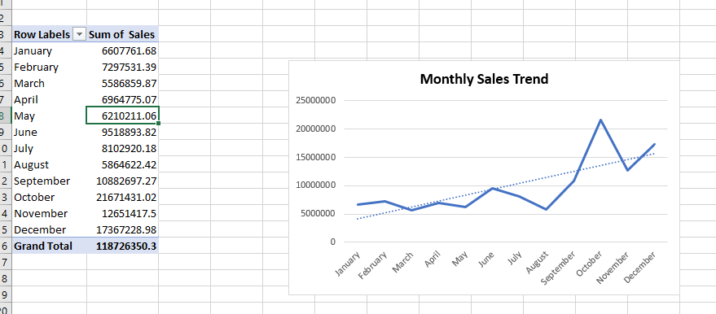

Slide 12
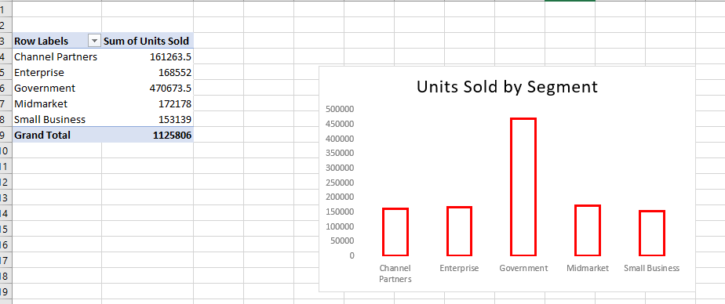

Slide 13
❖ Data Conversion to MySQL and Query Execution
After performing the initial analysis in excel, I converted the financial dataset into MySQL for more efficient data management and advanced querying:
Data conversion: I exported the data from excel into a CSV format and then imported it into MySQL using a directory method. This allowed me to work with a larger dataset in a more structured and scalable database environment.
Query execution: once the data was Imported, I ran queries to analyze key metrics such as total units sold per product and total units sold per segment. MySQL flexibility allowed me to filter, sort, and aggregate data quickly, providing deeper Insights into sales and profits across different regions and products.

Slide 14
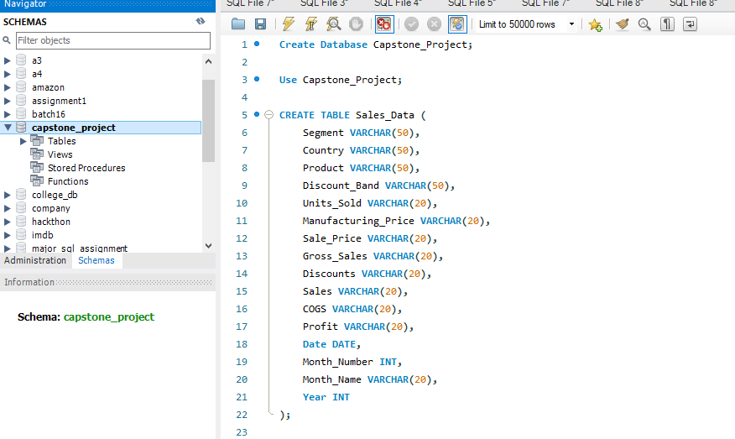

Slide 15
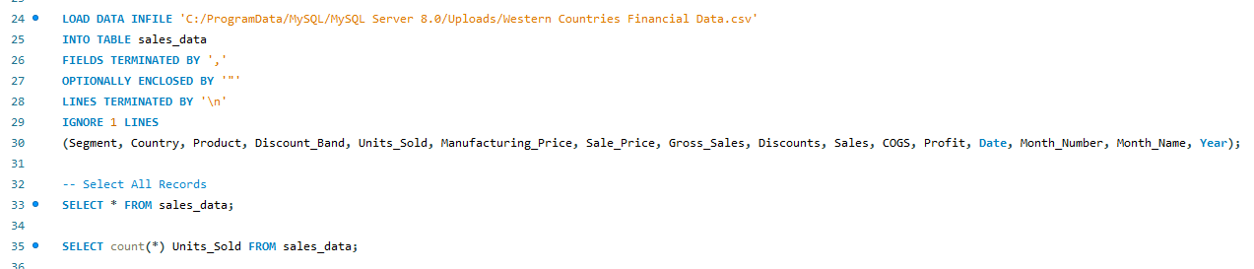

Slide 16
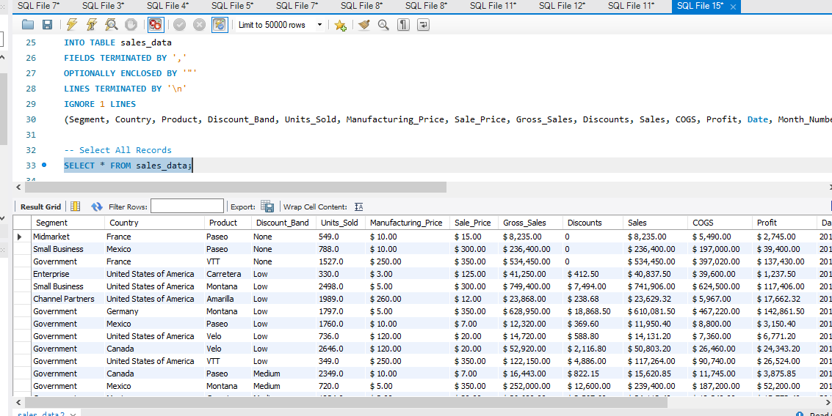

Slide 17
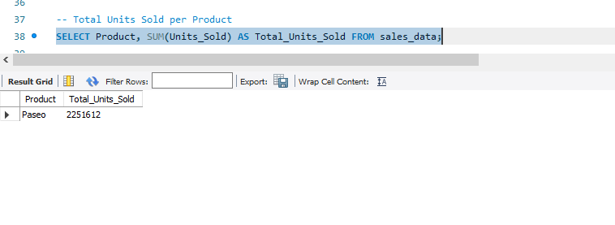

Slide 18
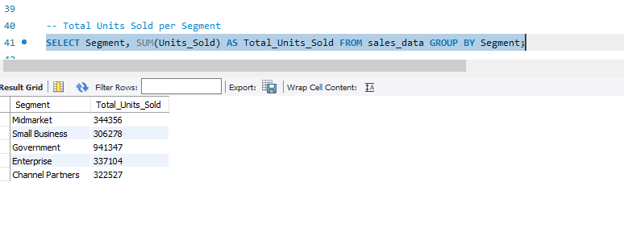

Slide 19
❖ Dashboard Creation In Power BI
After analyzing the financial data in MySQL, I imported the dataset into power BI to create an interactive dashboard titled "yearly sales and segment profit analysis“.
Data import: I connected power bi to the MySQL database and imported the relevant data tables, ensuring all financial metrics were available for visualization.
Visualizations: I designed various visual components to represent key insights, focusing on yearly sales performance and profit analysis by different market segments. This included visual representations that highlighted trends, comparisons, and distribution of profits across segments.
Interactivity: the dashboard included slicers and filters, allowing users to Interact with the data dynamically. This made it easy to analyze specific segments or time periods.
Insights: the dashboard provided a comprehensive overview of sales trends and segment profitability, enabling data-driven decision-making for strategic planning.

Slide 20
